Slide 1
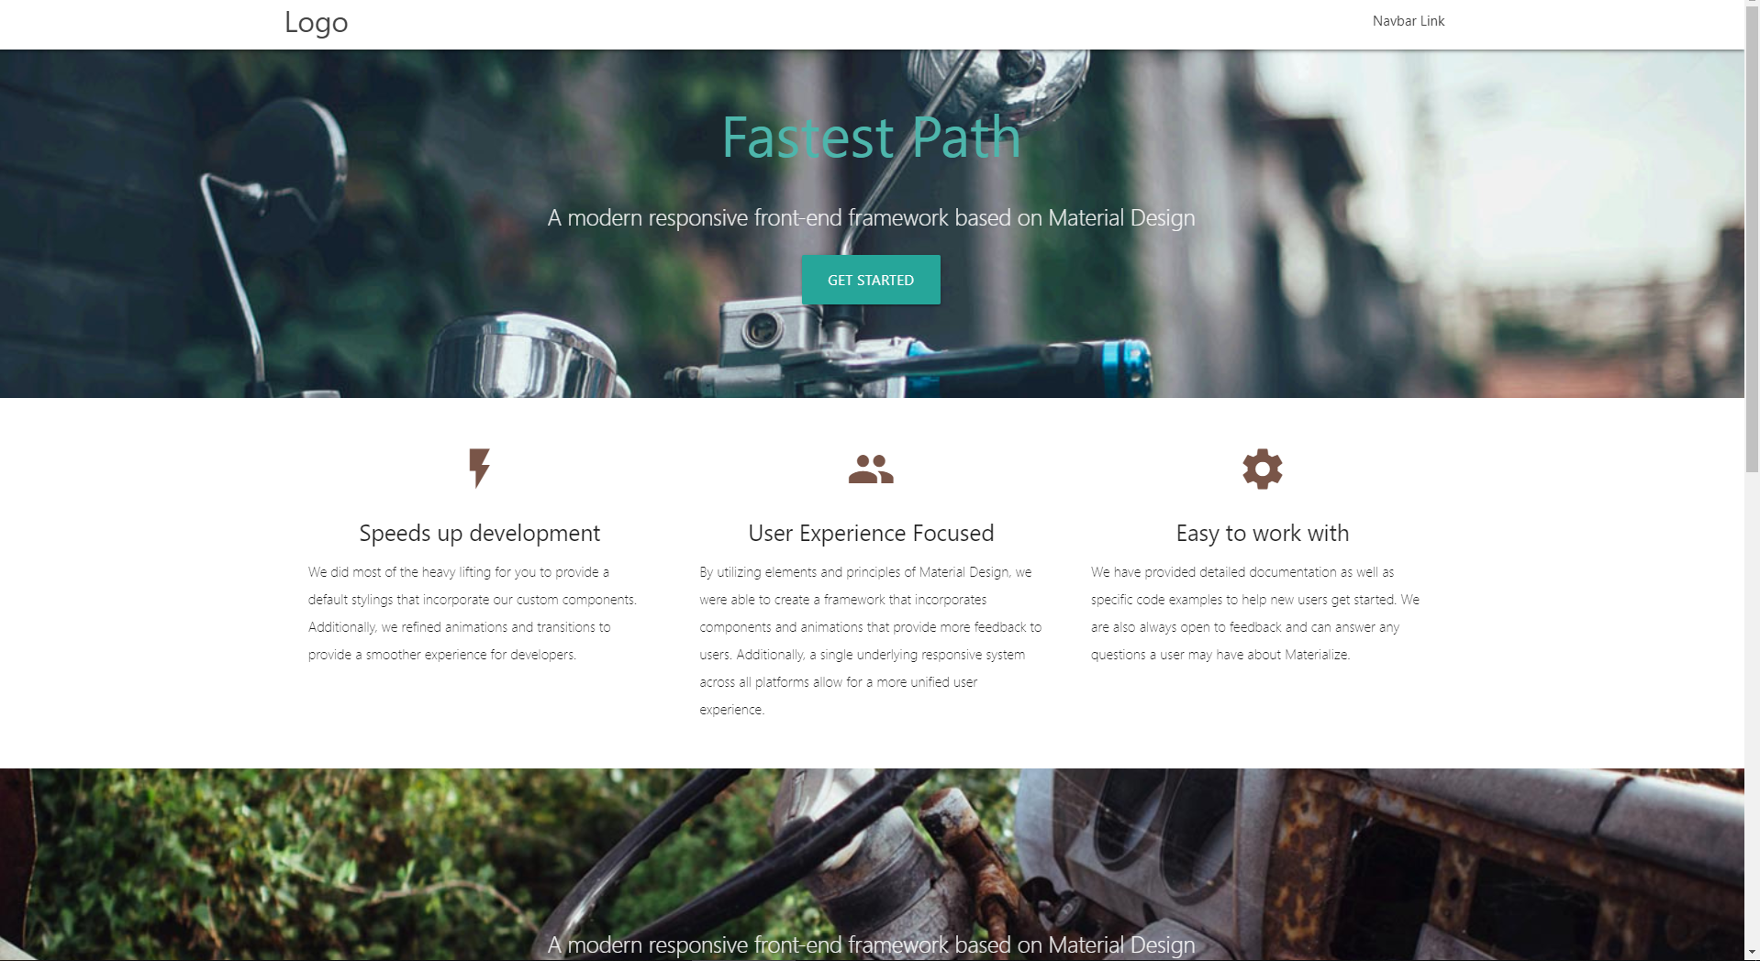
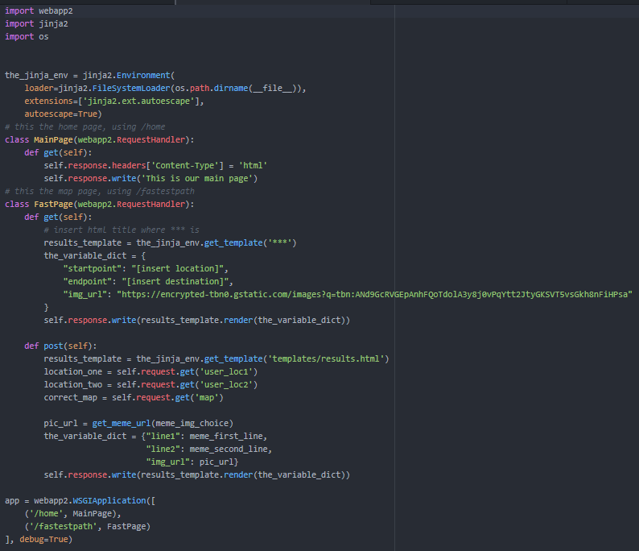
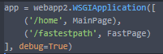
Day1M-Team 3: Fastest Path
Front End
Back End
Created Parallax Template ;)

Slide 2
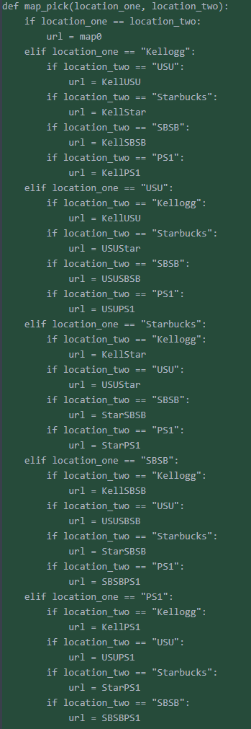
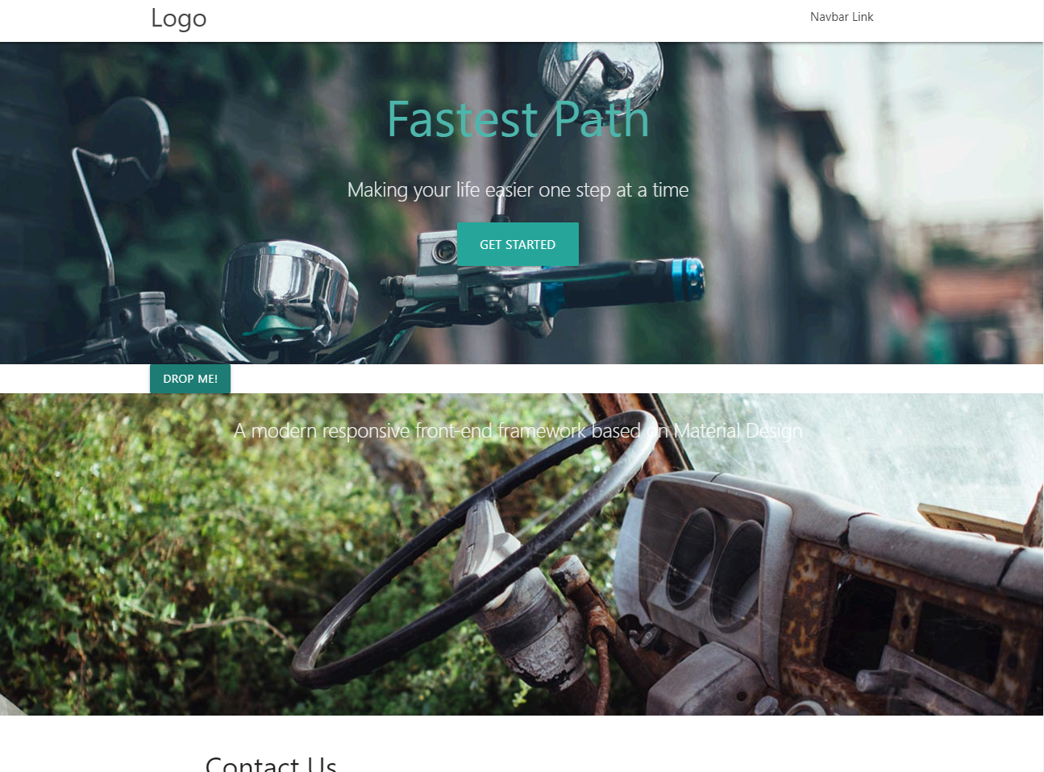
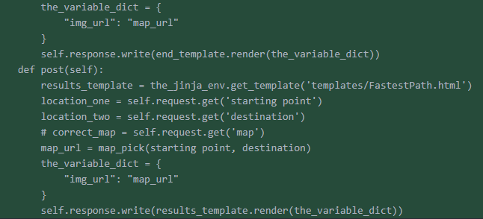
Day1A-Team 3: Fastest Path
Front End
Back End
Fixing Drop down menu

Slide 3
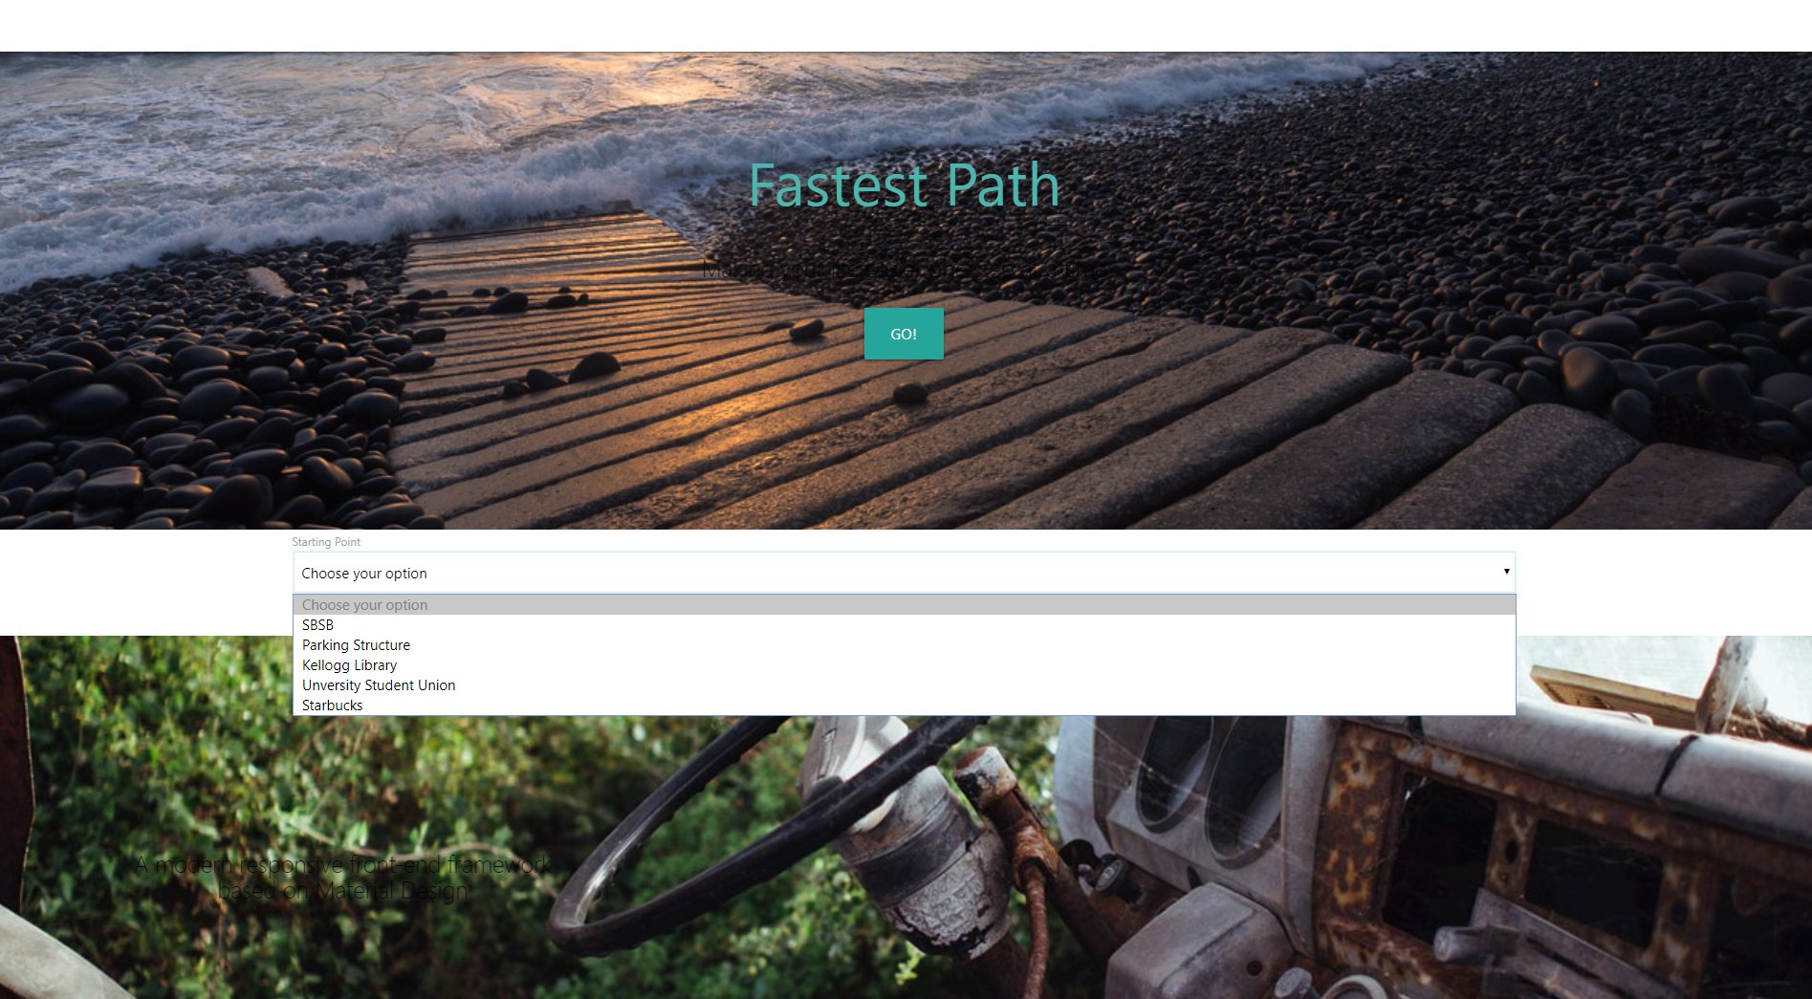
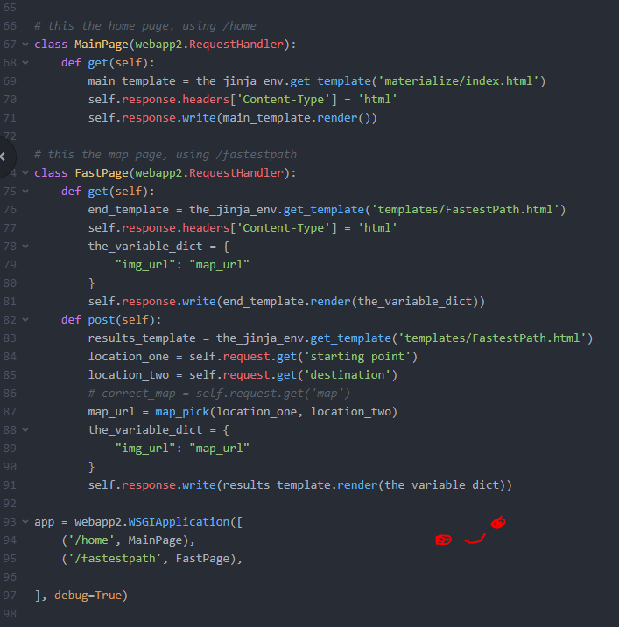
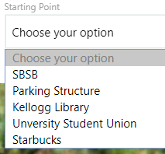
Day2M-Team 3: Fastest Path
Front End (Melissa & Francisco)
Back End (Uma & Marc)
Worked on the post and get requests
Fixed Drop down menu :D

Slide 4
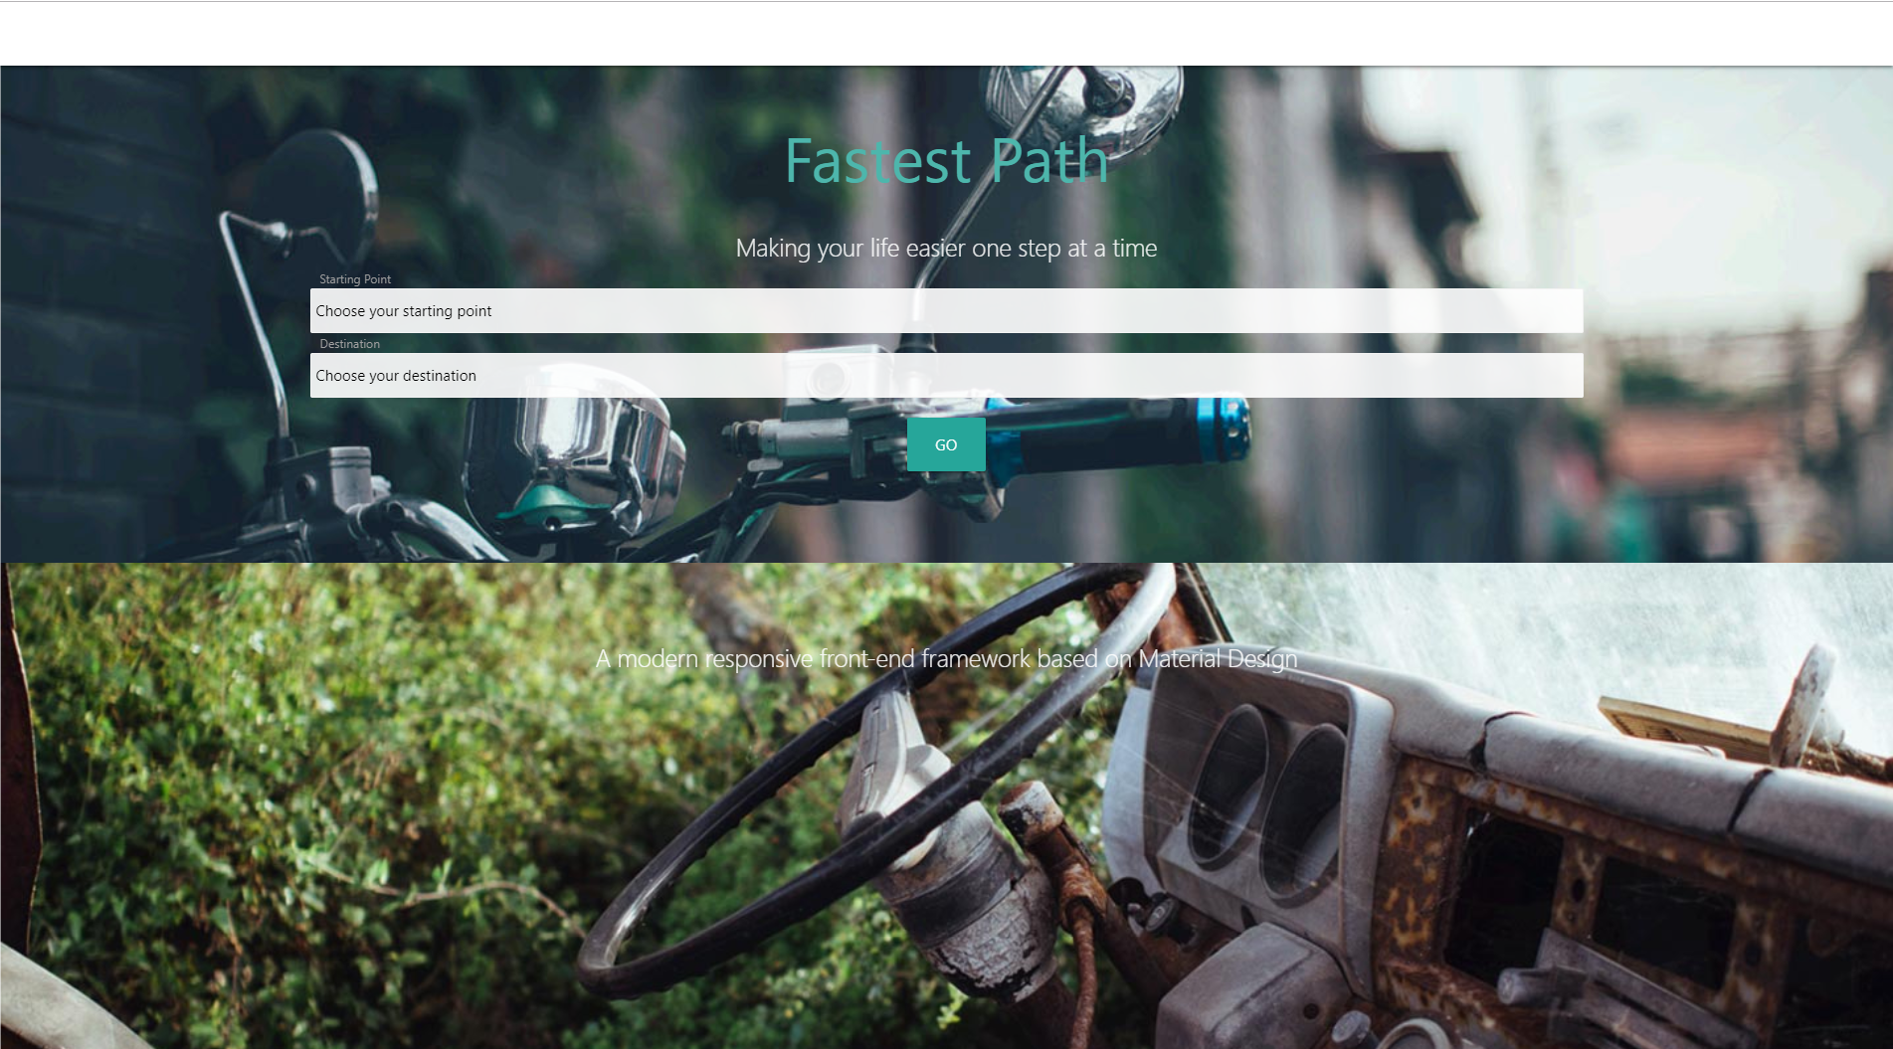
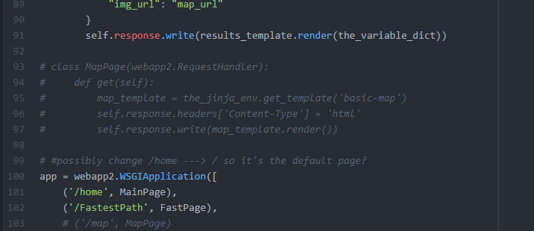
Day2A-Team 3: Fastest Path
Front End (Melissa & Francisco)
Back End (Uma & Marc)
Setup for the map page
Reformatted the page ☺

